Slide 1
PIP-104: PROFESSIONAL PRACTICE-II (INTERNSHIP) Viva-Voce Presentation FEDERATED LEARNING FOR TRAFFIC MONITORING
Submitted to the Presidency University, Bengaluru in partial fulfillment of the requirements for the PIP-104: PROFESSIONAL PRACTICE-II (INTERNSHIP)
By Rida Fathima
Batch No: 2020-2024
Under the supervision of
Dr. Srinivasan T R
Professor Department of Computer Science & Engineering January , 2024
Student Details
Name | Rida Fathima
Roll No | 20201CBC0042
Section | 7-CBC-1
Batch No | 2020-2024

Slide 2
Introduction and About Company or Organization
I worked under a International Internship Pilot Program (IIPP), Taiwan in National Chung Cheng University.
I worked under the The Research Center of Artificial intelligence and Sustainability.
IIPP is a programme Initiated by the National Science and Technology Council (NSTC).
NSTC expects that interns will engage in advanced studies or start a career in Taiwan.
Thus, IIPP has an intention to enrich the human resource of key scientific research fields in Taiwan.

Slide 3
About your team and reporting Manager
Throughout the internship, I had valuable interactions with the students and faculty in Taiwan. I also had a meeting with the Director and coordinator's of IIPP.
I also had a meeting once in every 3 weeks where I had to present a Report to my Professor, Dr. Pao Ann Hsiung. Our Supervisor helped us with doubts regarding the Research .
During my interactions with the professor, he provided guidance on FL concepts and how to go about the internship. His insights helped shape the direction of my research.
IIPP further wanted a report and experience based on every months progress
I also took guidance and suggestions from researchers in the Lab who have already worked on federated learning previously. This gave me more clarity and a kickstart to the research

Slide 4
About the Project
The overall goal of our project is to implement federated learning for traffic monitoring using vehicle detection across CCTV video footage collected by SP8. The main objective is to identify different vehicle types, such as cars, trucks, motorcycles, etc. The data collected from CCTV belongs to the Chiayi government. The objective is to Develop a robust vehicle detection model using YOLOv8 and finally Integrate Federated Learning into the vehicle detection system using the Flower framework. Federated Learning is a Distributed Machine Learning technique that enables collaborative training of models without centralizing data. This approach is particularly attractive for privacy sensitive applications, such as vehicle type detection, where data collection and sharing can be challenging.

Slide 5














Slide 6
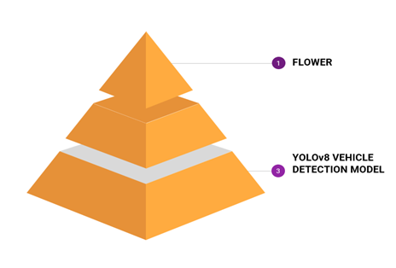
Objectives of the work
To make a vehicle detection model that accurately predicts the vehicles
To make Implement Federated Learning on the Vehicle Detection Model Successfully

Slide 7
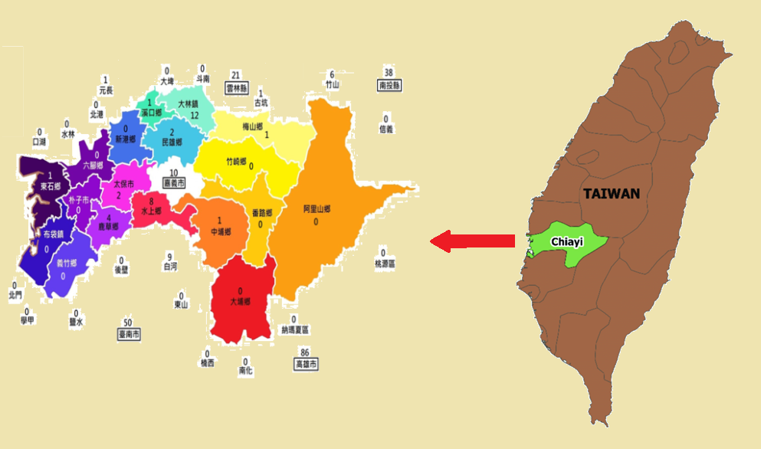
Problem Statement
Using Federated Learning to solve a Real Time Problem with Real Time data taken from Chiayi County CCTV Footages. Federated Learning is used because we cannot create a single classic ML model for the whole city since the data on each CCTV varies from one another. This is because it is a big County.

Slide 8
About the Working domain and the technology
The major advantages are Decentralization, Focus on Data Privacy and Collaborative nature.
Decentralization promotes training in a distributed fashion and thus minimizing transmission of Raw Data which in turn promotes Data Privacy.
Since Multiple clients are collaborating on a single model, it keeps the model updated on Latest Data Available.

Slide 9
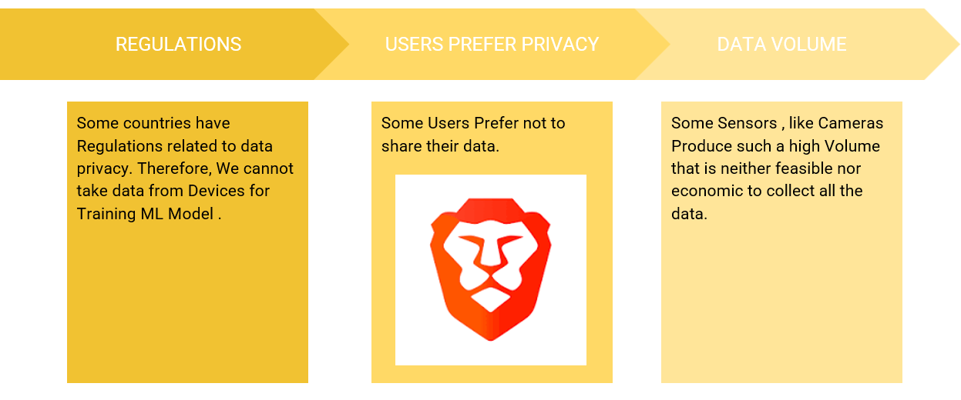
About the Working domain and the technology
Classic ML can only be used in circumstances where all the data is available on a single server. It cannot be used in scenarios when the data is not available on a centralized server or where the data available on one server is not enough to train a good model. It also cannot not be used easily in the Real-World scenarios due to Government Regulations, User Privacy Concerns and Large Data Volume issues..

Slide 10
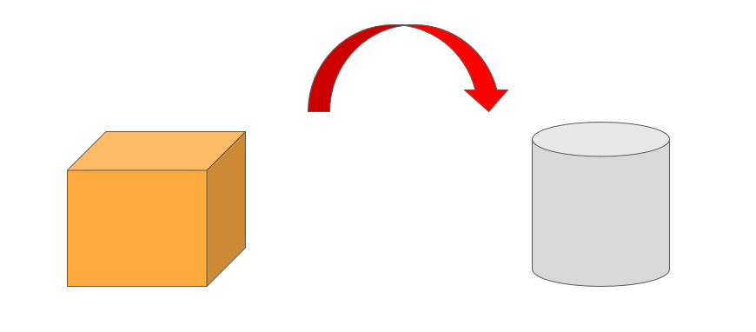
Methodology and Phases
The basic thing to understand about
Federated Learning is that the
Model Moves to the Data, Instead of
Data Moving towards the Model

Slide 11
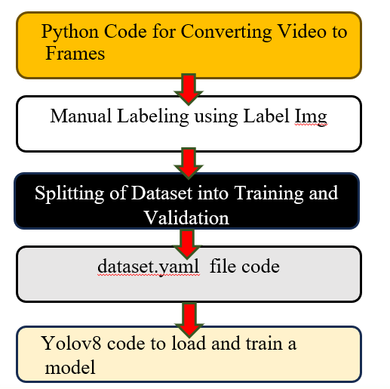
Methodology and Phases – Vehicle Detection Model Training

Slide 12
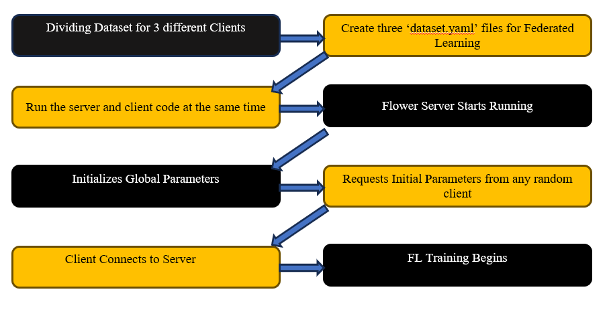
Methodology and Phases – Flower Implementation

Slide 13
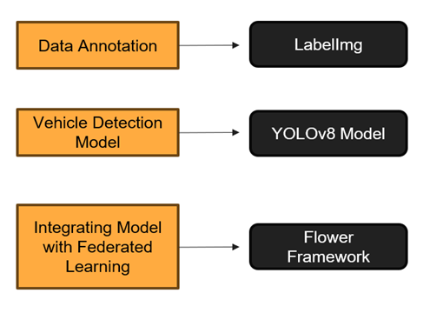
Project Work Flow Diagram

Slide 14
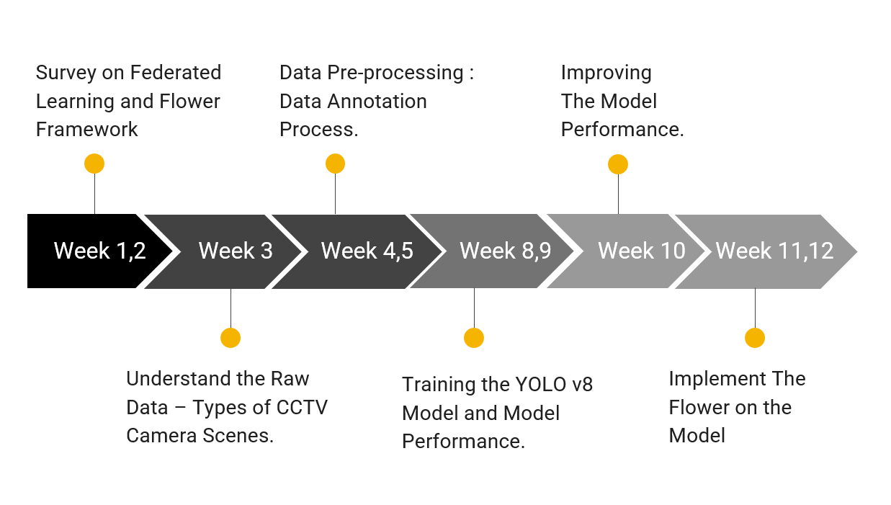
Project Work Flow Timeline

Slide 15
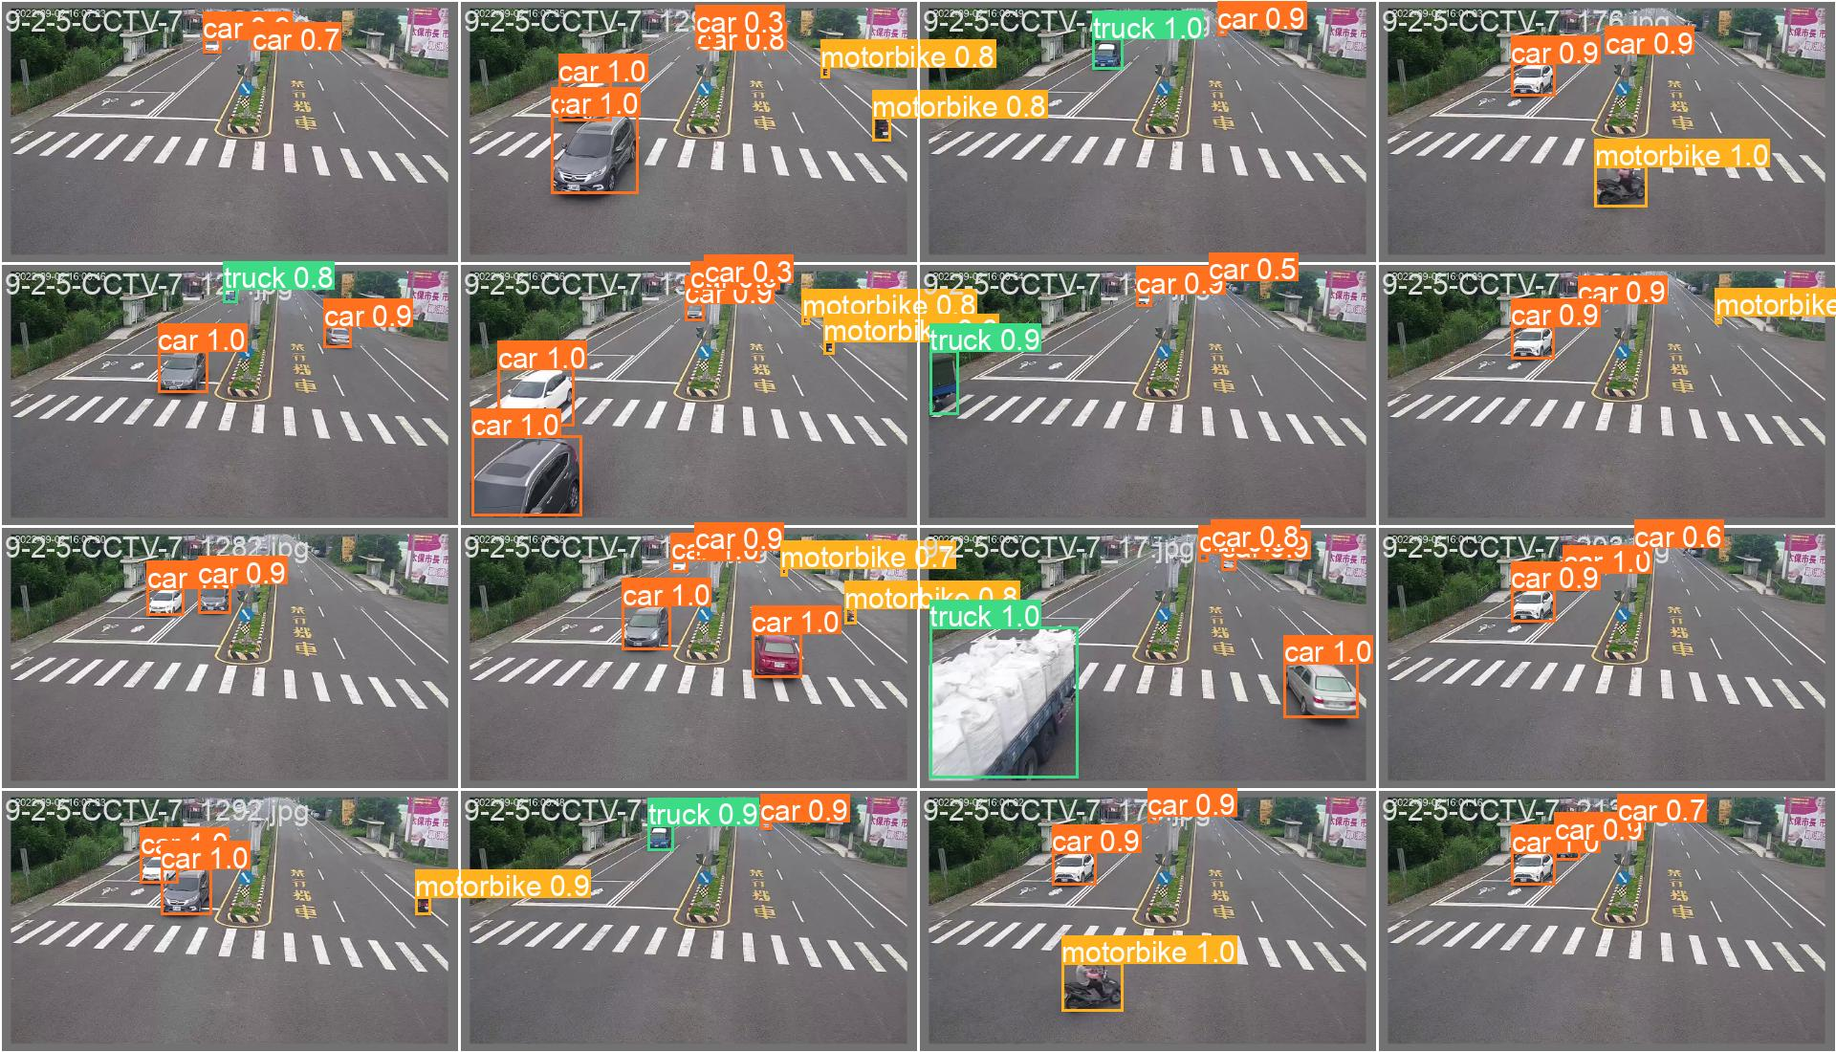
Results and Discussion – Vehicle Detection

Slide 16
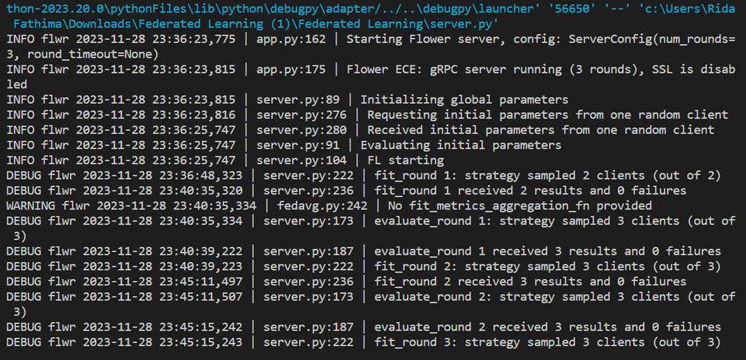
Results and Discussion – Flower Running

Slide 17
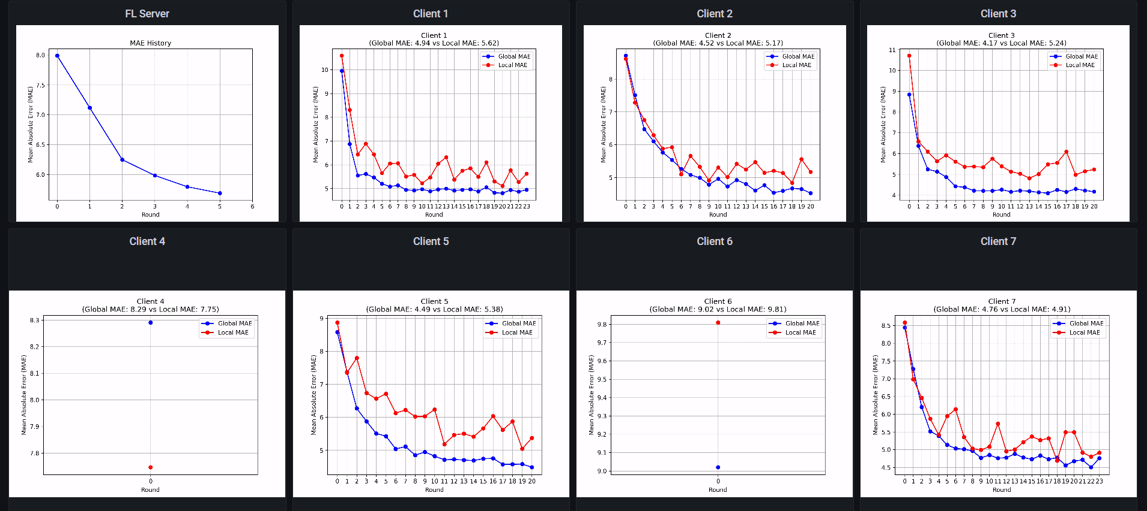
Results and Discussion – MAE Graph
MAE stands for Mean Absolute Error. It is a metric used to measure the performance of machine learning models. Shows how near the predicted value is to the true values.
The blue and red lines in the MAE plot represent the local and global MAE, respectively.
The lower the MAE, the better the performance of the model.

Slide 18
Challenges Faced in Internship
The main challenges faced in this project are implementation of the YOLOv8 model using Flower. Other Challenges faced were lighting, & weather conditions of dataset, and accuracy in vehicle detection. The night traffic scenes reflecting lights makes it harder to detect the type of vehicle. During rainy weather, the camera is covered with water droplets making it difficult to detect the type of vehicle. To address these challenges, I incorporated a diverse range of scenarios, and including different types of scenarios in each client would help the model understand all types of scenarios.

Slide 19
Conclusion
The successful implementation of federated learning for traffic monitoring will help us enhance the accuracy of vehicle detection across multiple CCTV feeds, which contributes to improved traffic management and safety.
Since different vehicles have different environmental impacts, Monitoring Vehicle Types also allows us to assess the Emissions and helps cities reduce air pollution, promoting sustainable transportation.

Slide 20

Q&A

Slide 21
Thank you !!

